Slide 1
Building Awesome AF Apps
Rachel Appel
Sr Content Developer for Azure
Microsoft
rachelap@microsoft.com
http://rachelappel.com

Slide 2
What is Azure Functions?

Slide 3



Code
Azure Function
Event + data

Slide 4
What is a Function?
Function as the unit of work
Functions are executed; they start and finish
Functions have inputs and outputs

Slide 5

The greatest thing since…

Slide 6

Azure Functions: Open Source
https://github.com/Azure/azure-webjobs-sdk
https://github.com/Azure/azure-webjobs-sdk-extensions
https://github.com/Azure/azure-webjobs-sdk-script
https://github.com/Azure/azure-webjobs-sdk-templates
https://github.com/ProjectKudu/WebJobsPortal

Slide 7
Function Examples
Timer Based
Transform CSV to Blob storage
SaaS event processing. Excel to Graph API
Web hook to create ad based on user profile
Async image processing or map data processing
Real time stream processing
Real time bot messaging
CRM System integration

Slide 8
Real World Scenarios
Package tracking
Vehicle tracking
Data cleanup and ETL
Batch processing
IoT Solutions
snow depth monitor; football equipment monitor
Internet traffic report aggregator

Slide 9
Function Apps vs API Apps
Function Apps
Data Processing
Microservice & serverless architecture
Performs executable routine
Does not have to be RESTful
Service and software integration
API Apps
CRUD operations
API Architecture
Manipulates or retrieves data
RESTful
Not generally for service and software integration

Slide 10
Demo
Azure functions overview

Slide 11
Serverless Computing

Slide 12
Run code, not computers
Notes:
gmail password
AzureFunctions123
azurefunctions@gmail.com

Slide 13
Serverless Computing
What is serverless?
PaaS
Stateless is scalable
Complicated
Sporadic workload
Perform an action rather than return data
APIs return data
Event driven

Slide 14
Serverless Code
Microservices
Variety of Languages
C#, F#
Node
Python, PHP, Batch, Bash
Event driven
Expose HTTP Endpoints

Slide 15
Scenarios for serverless patterns
Stateless and scale
Too complicated for a traditional project structure
Too simple for a traditional project structure
Workload is sporadic (very low or high)
Human involvement needs to stay low
Lots of different services involved
Integration of services or systems

Slide 16
Features & Benefits
Focus on business problems
No worries about infrastructure
No deployment
Lightweight
Cross-platform

Slide 17
Azure Functions Architecture

Slide 18
Functions PaaS Architecture
WebJobs Core
Programming model, common abstractions
WebJobs Extensions
Triggers, input and output bindings
Language Runtime
C# | Node | F# | PHP | Python | Bash | Batch
WebJobs Script Runtime
Azure Functions Host, Dynamic Compilation, Language abstractions
WebJobs Core
Programming model, common abstractions
WebJobs Extensions
Triggers, input and output bindings
App Service Dynamic Runtime
Hosting CI, Deployment Slots, Remote Debugging, etc..

Slide 19
Azure Functions Architecture
Functions
Runtime
Functions Programming Interface
Input Bindings
Triggers
Output Bindings
App Service
App Hosting Plans

Slide 20


Monolithic
Microservices

Slide 21

Built to scale
Notes:
When multiple triggering events occur faster than a single-threaded function runtime can process them, the runtime may invoke the function multiple times in parallel. If a function app is using the Consumption hosting plan, the function app could scale out automatically. Each instance of the function app, whether the app runs on the Consumption hosting plan or a regular App Service hosting plan, might process concurrent function invocations in parallel using multiple threads. The maximum number of concurrent function invocations in each function app instance varies based on the type of trigger being used as well as the resources used by other functions within the function app.

Slide 22
Programming Functions

Slide 23
Anatomy of a Function
Input
Output
Trigger
Code

Slide 24
A trigger causes a function to run
Blob Trigger
Event Hub Trigger
Generic Webhook Trigger
Github Webhook Trigger
Http Trigger
Manual Trigger
Queue Trigger
Service Bus Trigger
Timer Trigger
Only one trigger per function allowed.

Slide 25
Bindings: Input and Output
Access objects outside of your function from within it
Queues, tables, blobs, endpoints, etc…
A function may have multiple input or output bindings
Many bindings use Azure services or 3rd party services

Slide 26
Input bindings
Azure Blob Storage
External File (Preview)
External Table (Experimental)
Azure Storage Table
Azure DocumentDB Document
Azure Mobile Table Record
Bot Framework

Slide 27
Output bindings
Azure Event Hub
Azure Queue Storage
Azure Blob Storage
External File (Preview)
External Table (Experimental)
HTTP
Bot Framework
Azure Service Bus
Azure Table Storage
Azure DocumentDB Document
Azure Mobile Table Record
Azure Notification Hub
SendGrid (Preview)
Twilio SMS (Preview)

Slide 28
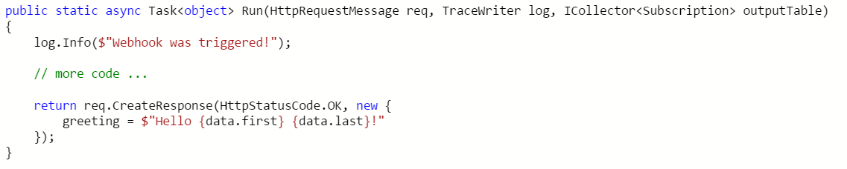
Output
Trigger
Input
Output

Slide 29
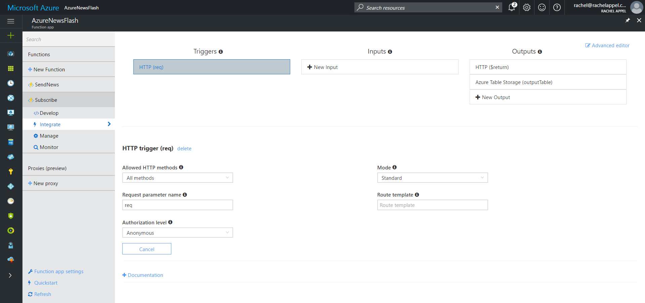

Slide 30
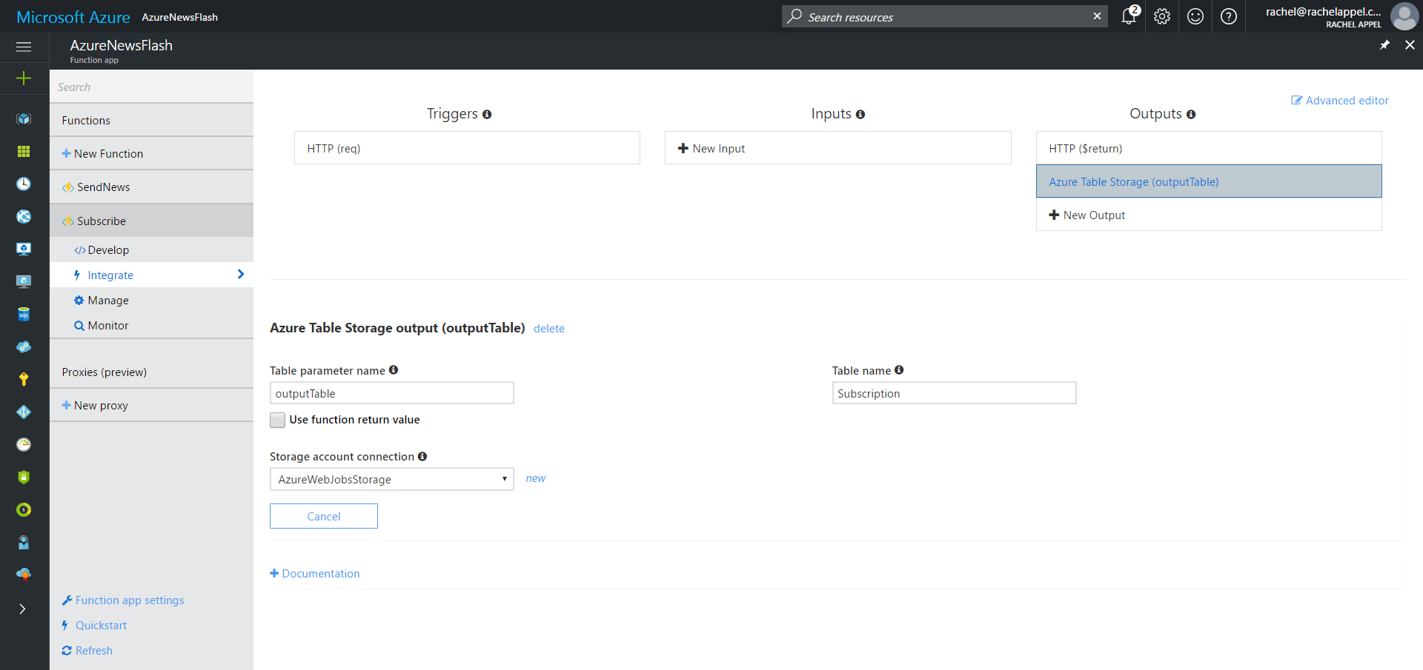

Slide 31
bindings matrix
Type | Trigger | Input | Output
Timer | ✔
HTTP (REST or WebHook) | ✔ |  | ✔
Blob Storage | ✔ | ✔ | ✔
Queues | ✔ |  | ✔
Azure Storage Table |  | ✔ | ✔
Azure Mobile Apps Table |  | ✔ | ✔
No-SQL DB |  | ✔ | ✔
Streams | ✔ |  | ✔
Push Notifications |  |  | ✔
Send Email |  |  | ✔

Slide 32
Functions are always static methods
Notes:
functions and routing
Functions define HTTP verbs and routes in function.json
In Web API, we put some decorators like HttpGet, HttpPost, HttpPut, HttpPatch and HttpDelete on each action to declare which HTTP verbs take which action, by combining with the Route decorator.
On the other hand, each function has a definition of HTTP verbs and routes on function.json. With this definition, different functions having the same route URI can handle requests based on HTTP verbs.
--------------

Slide 33
Bindings in Depth
Timer Trigger
HTTP Request/Webhook
Azure Storage Table
Blob Trigger
Queue Trigger

Slide 34
Timer Triggers
0 | */10 | * | * | * | *
“/” helps produce step values
“*” matches all values
“0” matches only 0
Day of week
Month
Day of Month
Hours
Minutes
Seconds

Slide 35
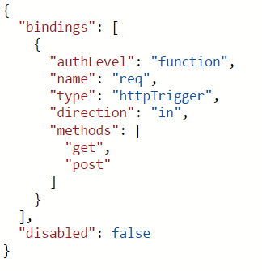
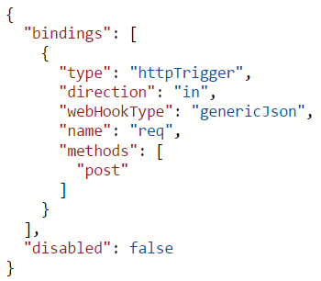
HTTP & Webhook bindings

Slide 36
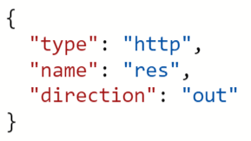
HTTP & Webhook bindings

Slide 37
Advanced Programming Techniques

Slide 38
Calling Other Functions
Use an output trigger followed by that same trigger, but as an input trigger to the next function to trigger
Must be inside same Function App

Slide 39
Reusing .csx code
#load “file.csx”
load classes, or functions
You can use a relative path with the #load directive:
#load “file.csx" loads a file located in the function folder.
#load “shared\file.csx" loads a file located in the shared folder in the function folder.
#load "..\shared\folder.csx" loads a file located in a folder at the same level as the function folder, that is, directly under wwwroot.
Notes:
This allows you use the type either as a binding parameter (if supported for your Function trigger type) or as an instance you create in code. Here’s an of using the Person class in an HTTP-triggered Function:
The #load directive works only with .csx (C# script) files, not with .cs files.

Slide 40
Imperative Binding
https://docs.microsoft.com/en-us/azure/azure-functions/functions-triggers-bindings#advanced-binding-at-runtime-imperative-binding

Slide 41
Environment Variables
To get an environment variable or an app setting value, use System.Environment.GetEnvironmentVariable, as shown in the following code example:+
Copy
C#
public static void Run(TimerInfo myTimer, TraceWriter log)
{
log.Info($"C# Timer trigger function executed at: {DateTime.Now}");
log.Info(GetEnvironmentVariable("AzureWebJobsStorage"));
log.Info(GetEnvironmentVariable("WEBSITE_SITE_NAME"));
}
public static string GetEnvironmentVariable(string name)
{
return name + ": " +
System.Environment.GetEnvironmentVariable(name, EnvironmentVariableTarget.Process);
}
Notes:
To get an environment variable or an app setting value, use System.Environment.GetEnvironmentVariable, as shown in the following code example:+
Copy
C#
public static void Run(TimerInfo myTimer, TraceWriter log) { log.Info($"C# Timer trigger function executed at: {DateTime.Now}"); log.Info(GetEnvironmentVariable("AzureWebJobsStorage")); log.Info(GetEnvironmentVariable("WEBSITE_SITE_NAME")); } public static string GetEnvironmentVariable(string name) { return name + ": " + System.Environment.GetEnvironmentVariable(name, EnvironmentVariableTarget.Process); }

Slide 42
Tools

Slide 43
Tools
Visual Studio Cloud Explorer
-and-
Visual Studio Tools for Azure Functions
Visual Studio Code Azure-functions extension
Microsoft Azure Storage Explorer

Slide 44
Debugging Function Apps
Postman
Test/Run in cloud
Visual Studio

Slide 45
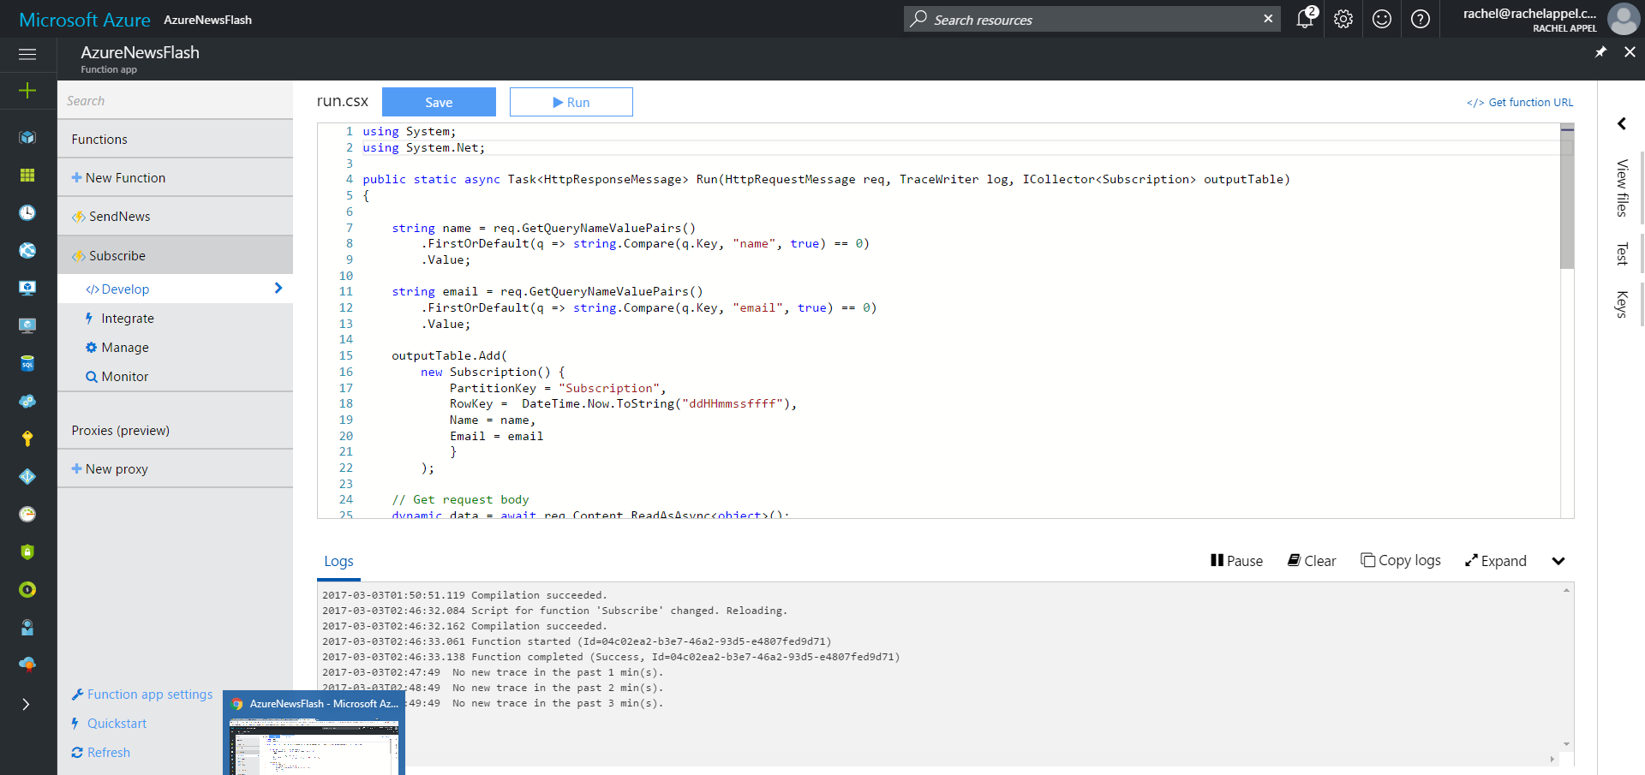

Slide 46
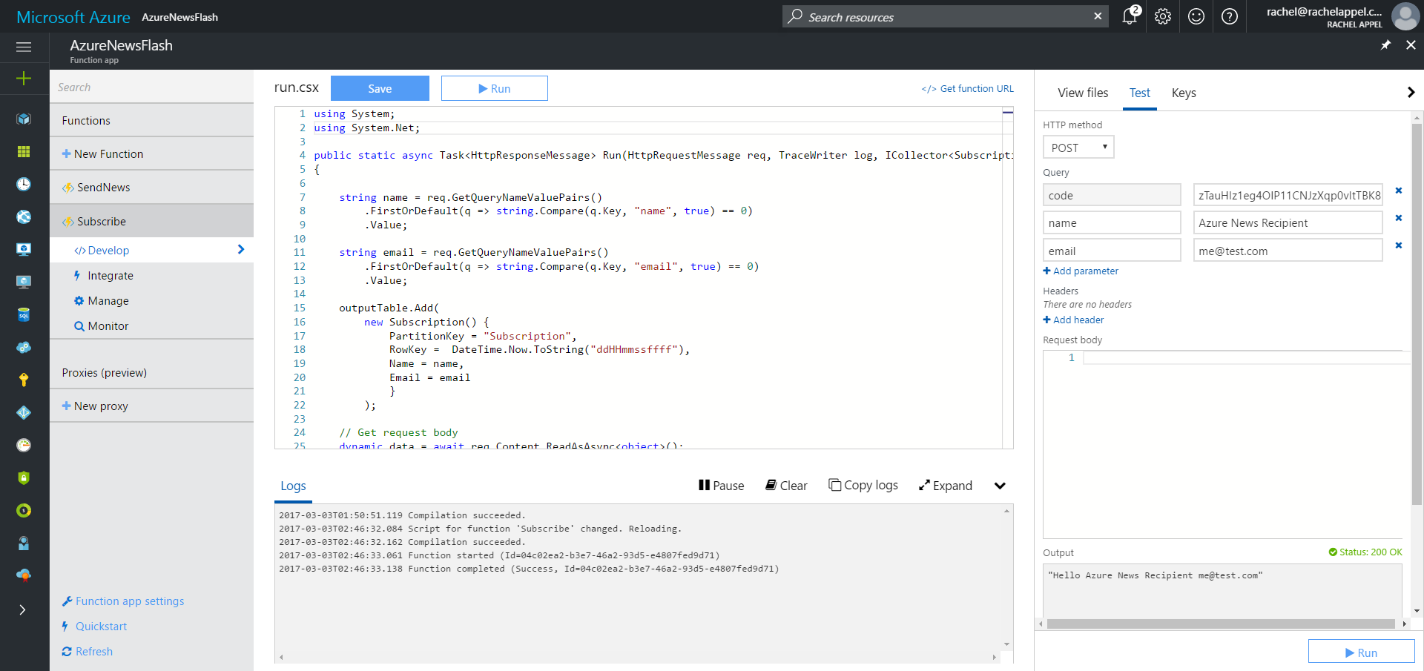

Slide 47
Scaling & Best Practices

Slide 48
Managing Workloads/Scaling
Keep functions idempotent and stateless
Async is best but avoid Task.Result
Avoid long running functions
Queues are best for cross function communication
Code in exception management
Notes:
In computing, an idempotent operation is one that has no additional effect if it is called more than once with the same input parameters. For example, removing an item from a set can be considered an idempotent operation on the set.
Asynchronous programming is a recommended best practice. However, always avoid referencing the Task.Result property. This approach essentially does a busy-wait on a lock of another thread. Holding a lock creates the potential for deadlocks.

Slide 49
Best Practices
Small, fast-running functions
Asynchronous > Synchronous
Caching and singletons (memory is shared between functions)
Avoid disk operations (shared across functions)
Use App Service guidelines

Slide 50
Settings & Deployment

Slide 51
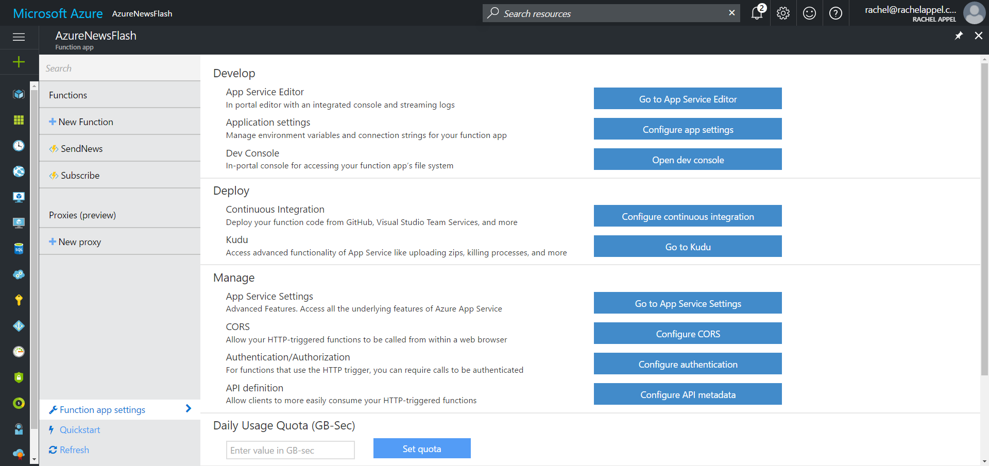

Settings

Slide 52
Deployment
Functions are an App Service
Continuous Integration
Download and setup in Github locally, then push

Slide 53
https://blogs.msdn.microsoft.com/appserviceteam/2017/03/16/publishing-a-net-class-library-as-a-function-app/

Slide 54
Questions?
Rachel Appel
Sr Content Developer for Azure
Microsoft
rachelap@microsoft.com
http://rachelappel.com

